Slide 1
Linear Dynamical Systems
CSCI 4360/6360 Data Science II

Slide 2
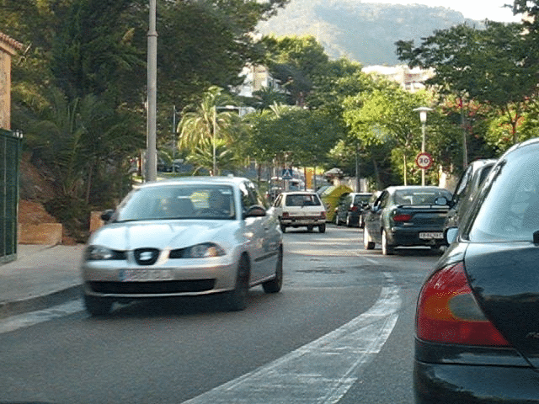

Last time…
Motion analysis via optical flow
Parametric vs energy-based formulations
Importance of assumptions
Modern formulations
Robustness to outliers (large optical flow)
Relatedness to markov random fields
Coarse-to-fine image pyramids

Slide 3



Today
A specific type of motion: dynamic textures

Slide 4
Dynamic textures
“Dynamic textured sequences are scenes with complex motion patterns due to interactions between multiple moving components.”
Examples
Blowing leaves
Flickering flames
Water rippling
Multiple moving components: problematic for optical flow
How to analyze dynamic textures?

Slide 5
Dynamical Models
Goal: an effective procedure for tracking changes over sequences of images, while maintaining a certain coherence of motions

Slide 6
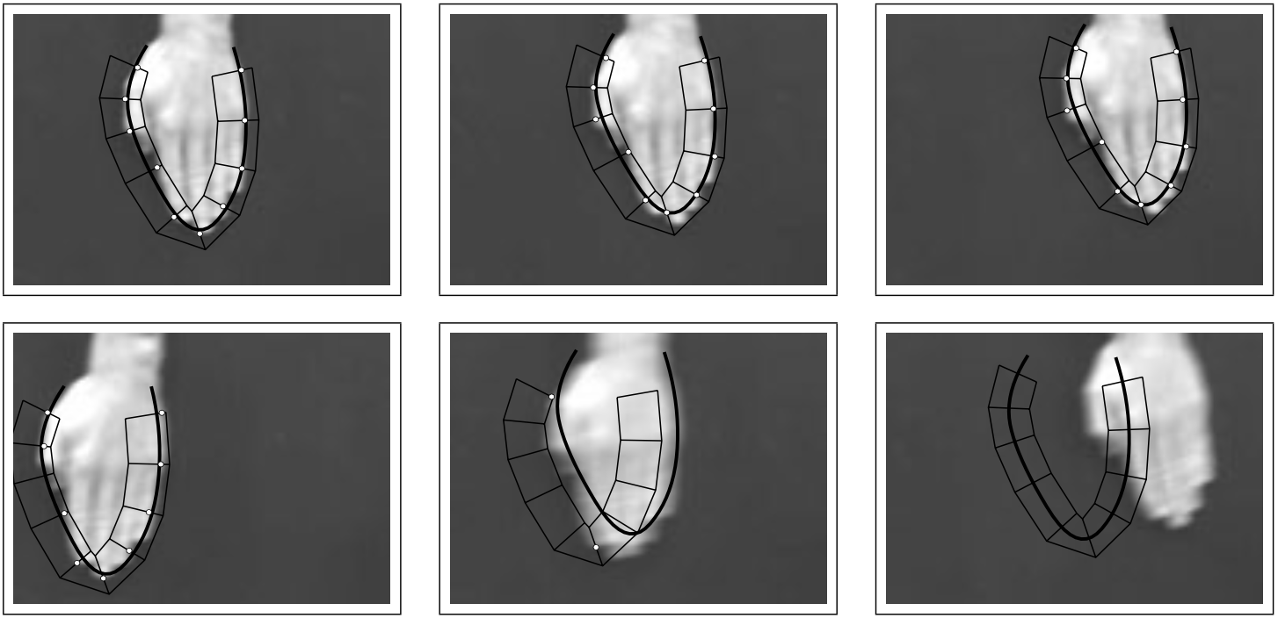
Dynamical Models
Hand tracking
Top row: slow movements
Bottom row: fast movements
Fixed curves or priors cannot exploit coherence of motion

Slide 7


Linear Dynamical Models
Two main components (using notation from Hyndman 2006):
Appearance Model
State Model

Slide 8
Autoregressive Models
This is the definition of a 1st-order autoregressive (AR) process!
Each observation (x_{t}) is a function of previous observations, plus some noise
Markov model!

Slide 9
Autoregressive Models
AR models can have higher orders than 1
Each observation is dependent on the previous d observations

Slide 10
Appearance Model
Output matrix
y_{t}: image of height h and width w at time t, usually flattened into 1 x hw vector
x_{t}: state space vector at time t, 1 x q (where q <<< hw)
u_{t}: white Gaussian noise
C: output matrix, maps between spaces, hw x q
Image in a sequence
Low-dimensional “state”
Noise inherent to the system

Slide 11
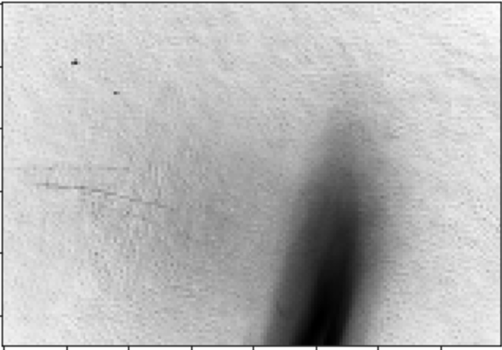
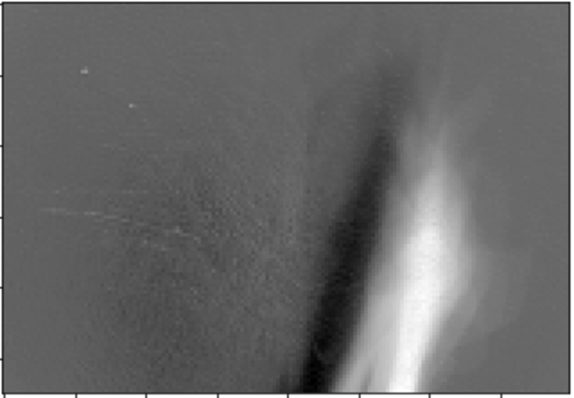
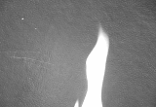
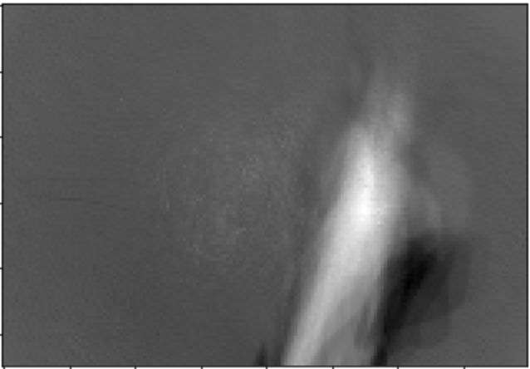
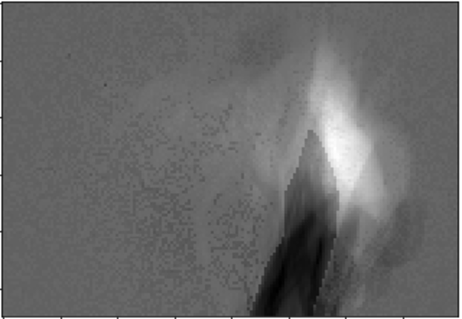
Appearance Model
PC 1
PC 2
Each of these is 1 column of C.
There are q of them (first 4 shown here).
PC 3
PC 4

Slide 12




Appearance Model
How do we learn the appearance model?
Choose state-space dimension size q
Noise term is i.i.d Gaussian
U-hat is a matrix of the first q columns of U
V-hat is a matrix of the first q columns of V, and sigma-hat is a diagonal matrix of the first q singular values

Slide 13
State Model
State transition matrix
x_{t} and x_{t-1}: state space vectors at times t and t – 1, each 1 x q vector
A: transition matrix, q x q matrix
W: driving noise, q x q matrix
v_{t}: white Gaussian noise
Low-dimensional state at time t
Low-dimensional state at t - 1
Driving noise

Slide 14
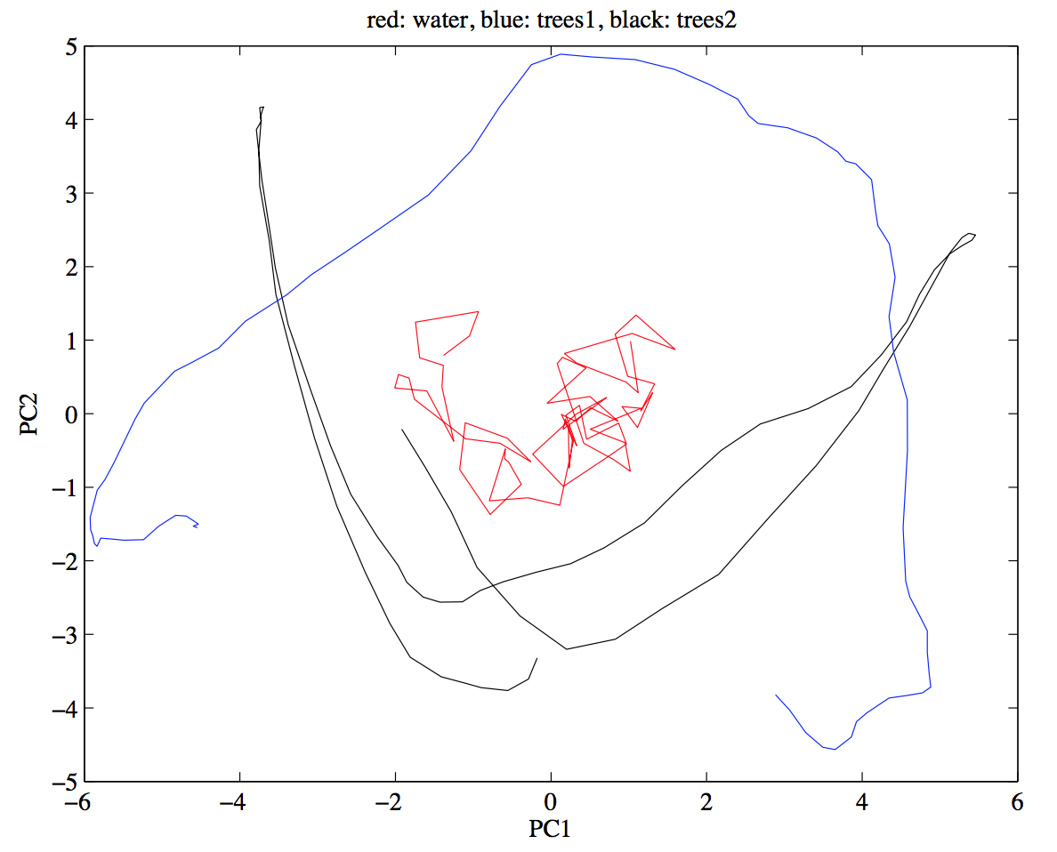
State Model
Three textures
q = 2

Slide 15
State Model
How do we learn the state model?
Homework 2, ahoy!

Slide 16
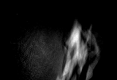

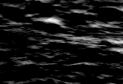
LDS as Generative Models
Once we’ve learned the parameters, we can generate new instances
Major strength of LDS!
Notes:
Don’t need a massive transformer model to do it

Slide 17
Problems with LDS
PCA = Linear + Gaussian
What if the state space isn’t linear, or data aren’t Gaussian?
Nonlinear appearance models
Wavelets
IsoMap
LLE
Kernel PCA
Laplacian Eigenmaps
These introduce their own problems!

Slide 18

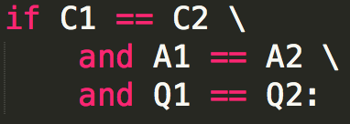

Problems with LDS
Comparing LDS models
Given a sequence Y:
New sequence Y’:
How do we compare these systems?
Despite linear formulation, are NOT Euclidean
Valid distance metrics include spectral methods and distribution comparators

Slide 19
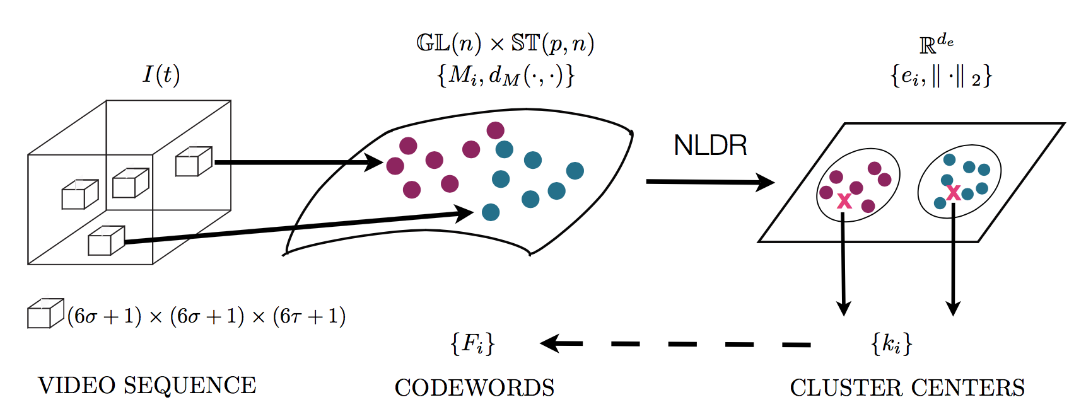
Comparing LDS
Select multiple, non-overlapping patches from each video
Build LDS for each patch

Slide 20
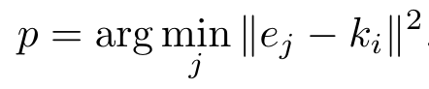
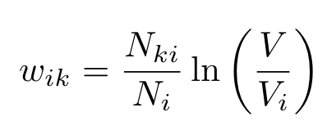
Comparing LDS
Embed the LDS in low-dimensional space
We’ll come back to this when we discuss embeddings!
Compute cluster centroids in embedding space
These centroids become codewords
Represent videos as a document of codewords
Compute TF-IDF
Perform classification on document weight vectors

Slide 21
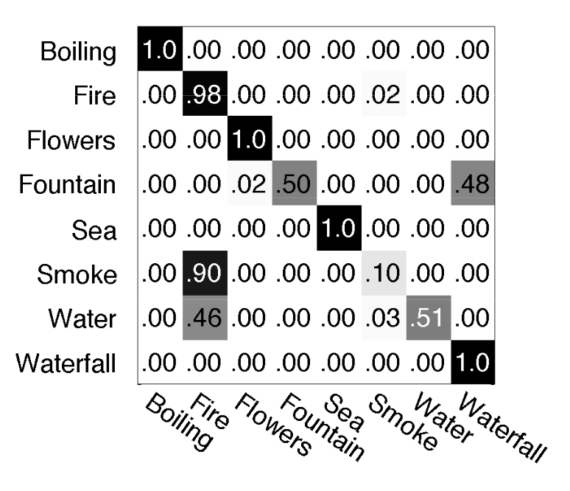
Comparing LDS
Notes:
88 video sequences
- varying number of sequences per class (so some classes may be over/under represented)
- trained on 50% of the data, tested on the rest
Smoke, water, and fountain are clearly the most difficult

Slide 22
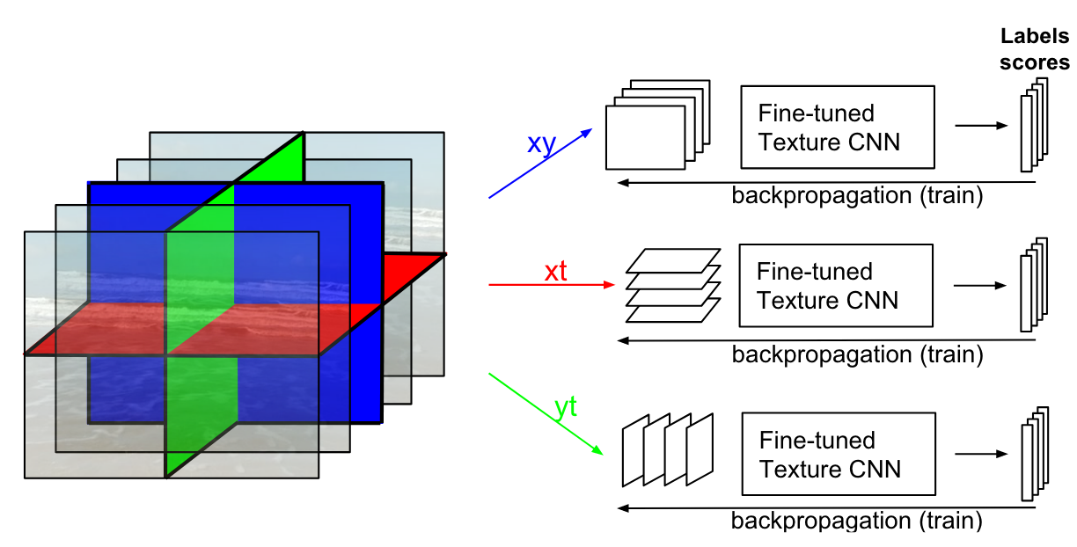
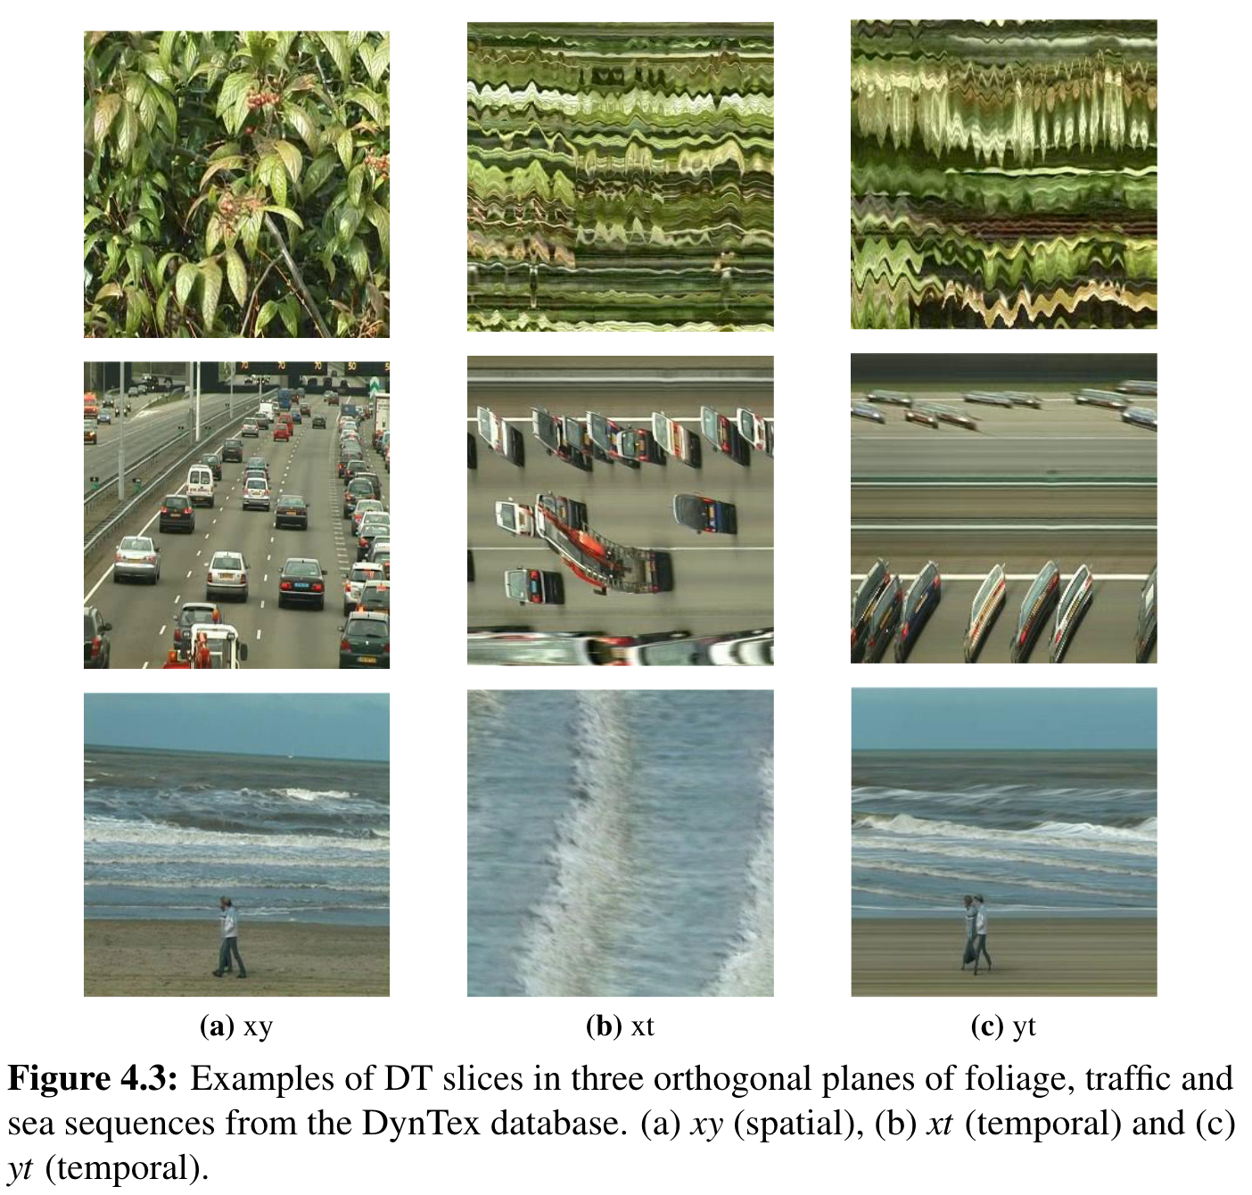
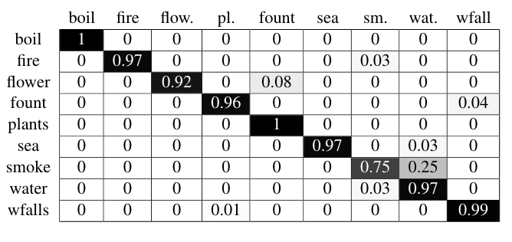
Deep learning + dynamic textures
Notes:
Deep networks do a lot better!
- Train on each “plane” of the data independently
– Much more robust at recognizing each dynamic texture
- Uses standard CNNs

Slide 23
Mamba state space models
Motivated by performance and space considerations of Transformer architectures in large language models
(Conceptual) combination of RNN + CNN + AR models
Innovations
Input selection mechanism
Hardware-aware algorithm
Architecture
Vision Mamba (ViM) for image processing
We’ll get into this more when we get to deep networks. For now:

Slide 24
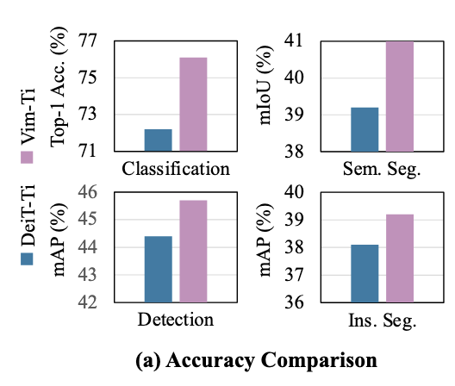
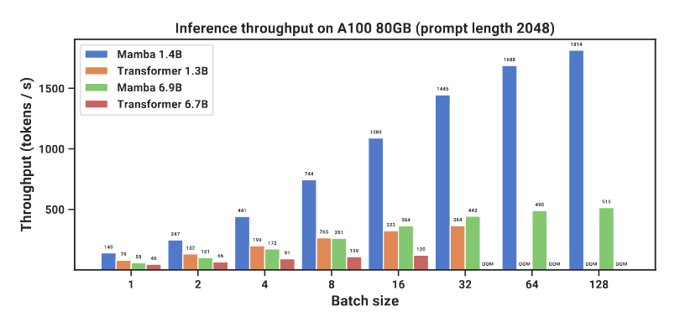
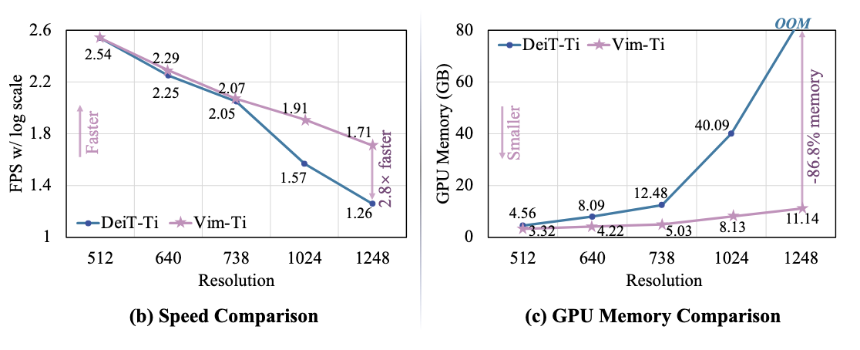
Mamba state space models
Upshot: beat Transformer models of same parameter size, equivalent performance to Transformer models of 2x parameter size
Much faster inference across the board (ie, generation) and with fewer resources

Slide 25
Conclusion
Dynamic textures are motion with statistical regularity
Regularity can be exploited through parametric representation
Linear dynamical systems (LDS)
Autoregressive models (AR)
Markov assumption
Representation model + State model
Generative models
Deep networks can learn the same feature set and in some cases exceed the performance of LDS (though are harder to train)
Mamba state space models make LDS-like architectures cool again

Slide 26
References
Hyndman et al, “Higher-order Autoregressive Models for Dynamic Textures”, BMVC 2007 http://www.cs.toronto.edu/~fleet/research/Papers/DynamicTextures.pdf
Shumway and Stoffer, Time Series Analysis and Its Applications (3rd ed.), Chapters 3 and 6, http://www.db.ucsd.edu/static/TimeSeries.pdf
Blake and Isard, Active Contours, Chapter 9-11, http://ww.vavlab.ee.boun.edu.tr/courses/574/material/books/blake_Active_Contours.pdf
Doretto et al, “Dynamic Textures”, IJCV 2003 https://escholarship.org/uc/item/2m50f2fb
Woolfe et al, “Shift Invariant Dynamic Texture Recognition”, ECCV 2006 https://link.springer.com/chapter/10.1007%2F11744047_42?LI=true
Ravichandran et al, “View-invariant dynamic texture recognition using a bag of dynamical systems”, CVPR 2009 http://ieeexplore.ieee.org/abstract/document/5206847/
Andrearczyk, Vincent. “Deep learning for texture and dynamic texture analysis”, 2020 https://doras.dcu.ie/22040/1/Vincent_Andrearczyk_Final_PhD_thesis.pdf
Gu et al, “Mamba: Linear-Time Sequence Modeling with Selective State Spaces”, 2023 https://arxiv.org/abs/2312.00752
Zhu et al, “Vision Mamba: Efficient Visual Representation Learning with Bidirectional State Space Model”, 2024 https://arxiv.org/abs/2401.09417

